Slide 1
Exploratory Data Analysis on Crimes in Chicago Dataset 2001-17
Mustafa Habeeb - mhabee2 - 669175038
Ibrahim Ayoob - iayoob2 - 675374281
Vidhyasagar Udayakumar - vudaya2 - 652709869

Slide 2
Problem Selection
Problem: Our team will be exploring the Crimes in the Chicago data set while analyzing the crimes that are committed in the community areas of Chicago throughout various times of the day. We will be using classification and clustering techniques to produce our outputs and create visualizations of what crimes are trending throughout the years.
Solution: Visualize what crimes are happening in specific community areas and help notify the public of the areas that are the most dangerous depending on time of day and show a general trend of crimes that are happening throughout the year
The datasets we will be using are from the Crimes in Chicago dataset from 2001- 2017. The data is available at https://www.kaggle.com/currie32/crimes-in-chicago.

Slide 3
Data Collection
4 CSV files with the Chicago Crime data is obtained from the kaggle platform.
When the csv files are merged, more than 7.8 million observations were obtained.
Decided to use every 8th observation to create the classification and clustering models.

Slide 4
Data Preparation
TimePeriod, Primary Crime Type, Major Section are the columns which are created using the values in ‘Date’, ‘Primary Type’, ‘Community Area’ respectively.
For starters, instead of simply having the time stamp in one column, we separated it out so then we can create a new column called ‘TimePeriod’.
Handle Missing Values:
Only the required varaibles were used from the dataset and they are
(Date, Year, TimePeriod, Primary Crime Type, Arrest, Community Area, District, Major Section, Loc Type)

Slide 5
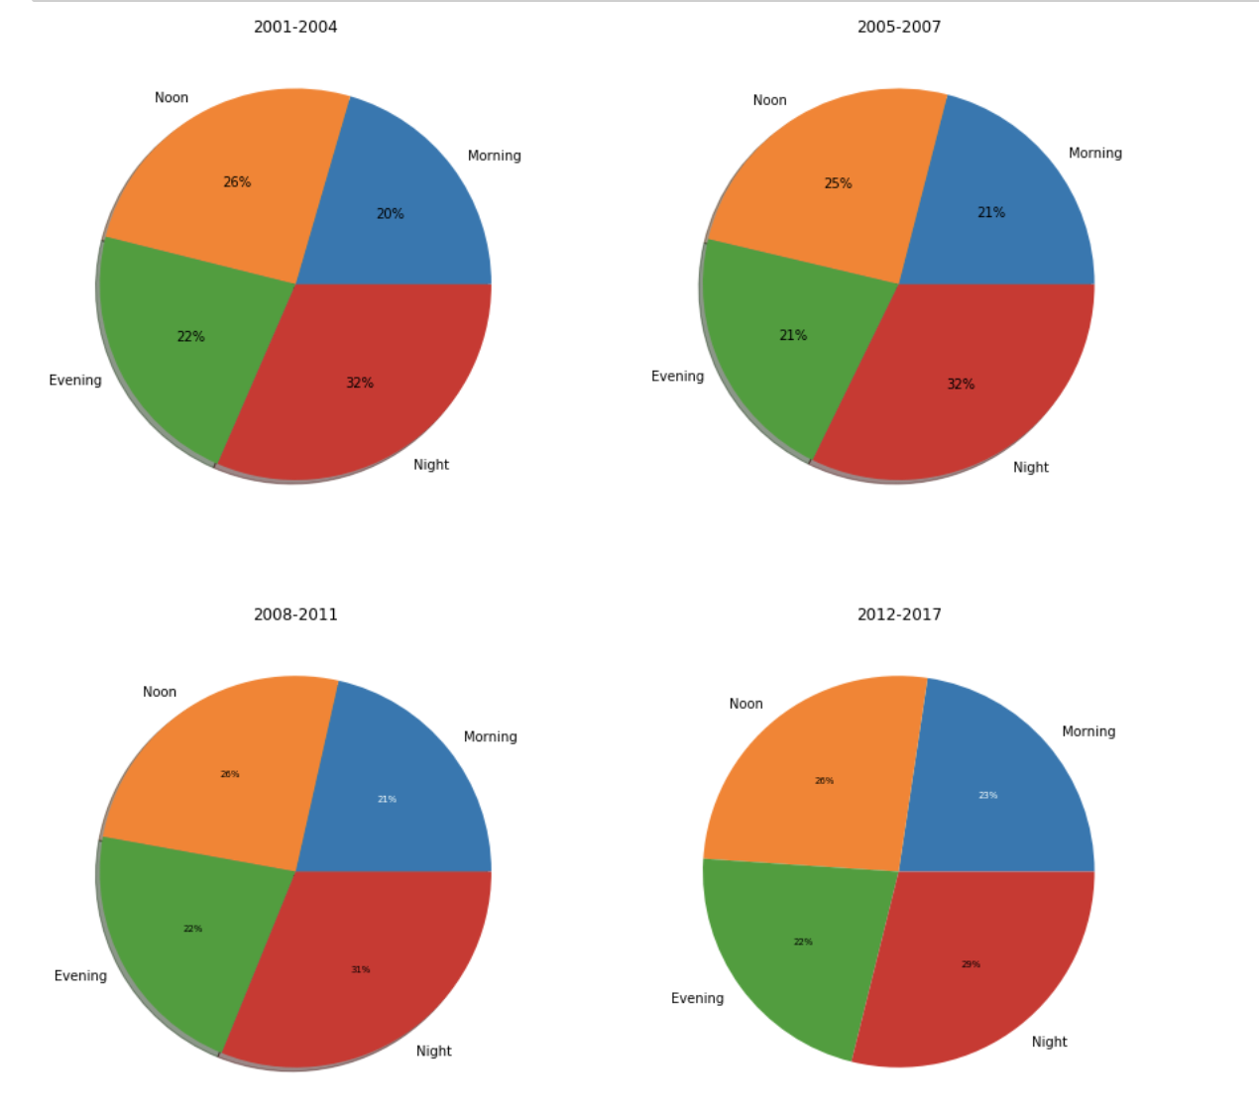
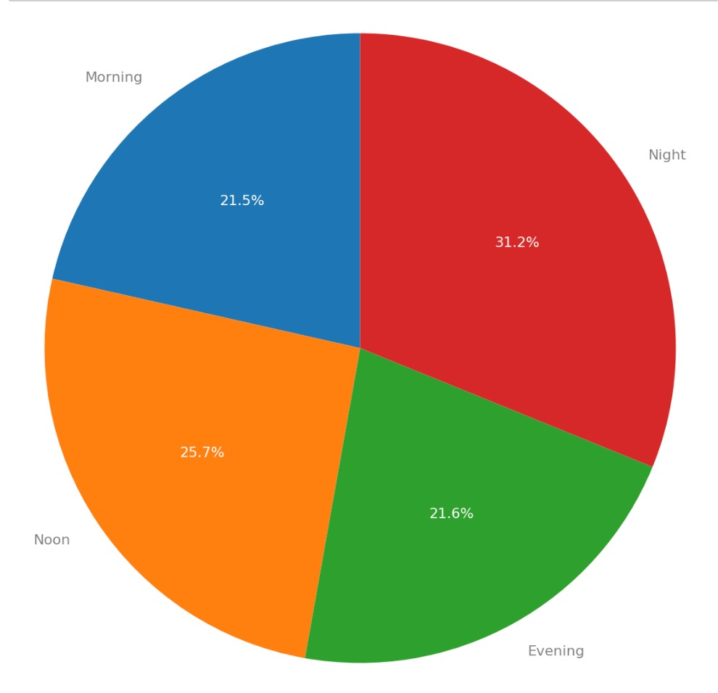
Data Exploration

Slide 6
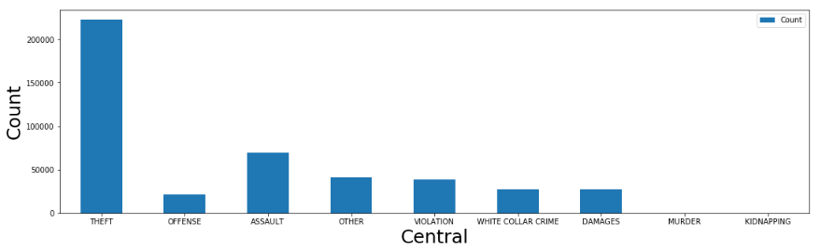
Data Exploration

Slide 7
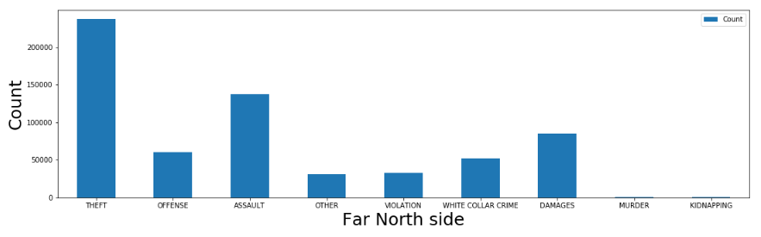
Data Exploration

Slide 8
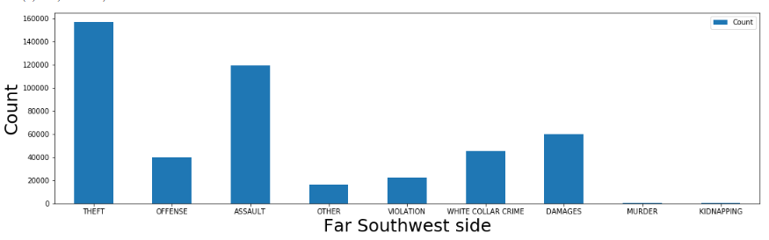
Data Exploration

Slide 9
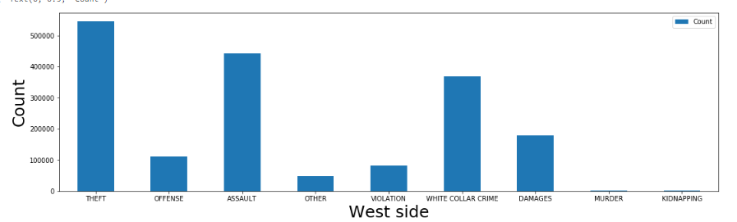
Data Exploration

Slide 10
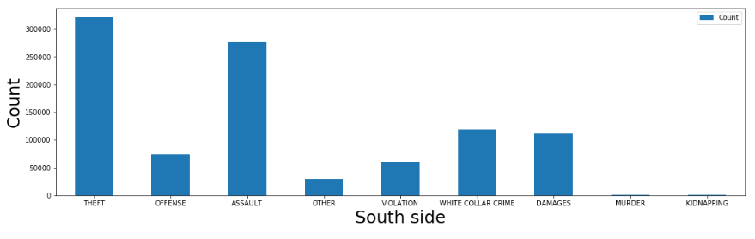
Data Exploration

Slide 11
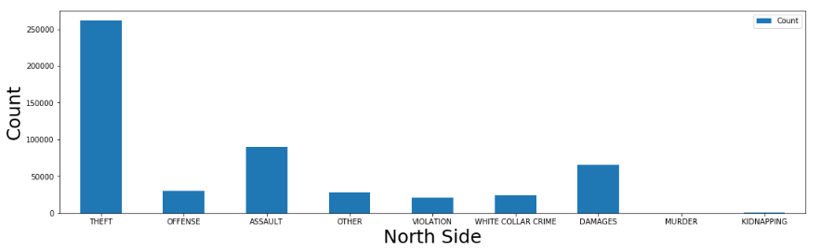
Data Exploration

Slide 12
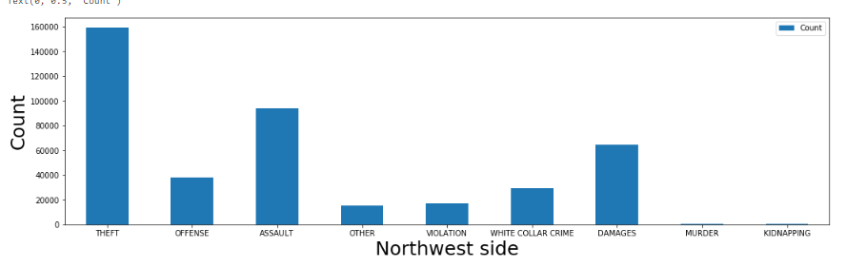
Data Exploration

Slide 13
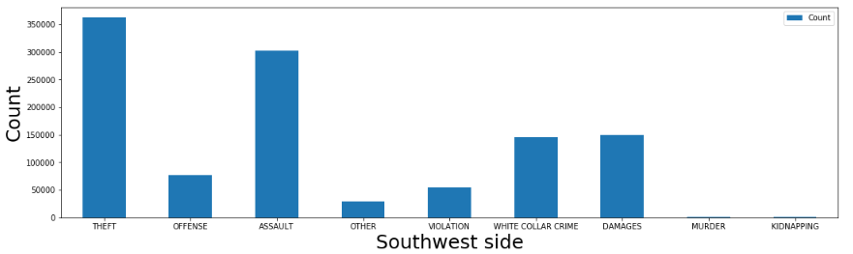
Data Exploration

Slide 14
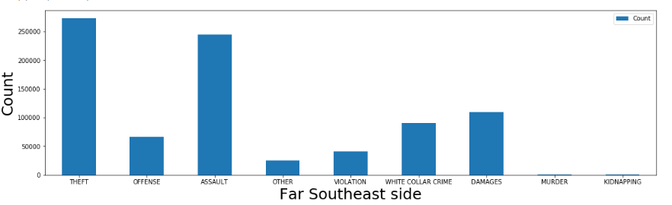
Data Exploration

Slide 15
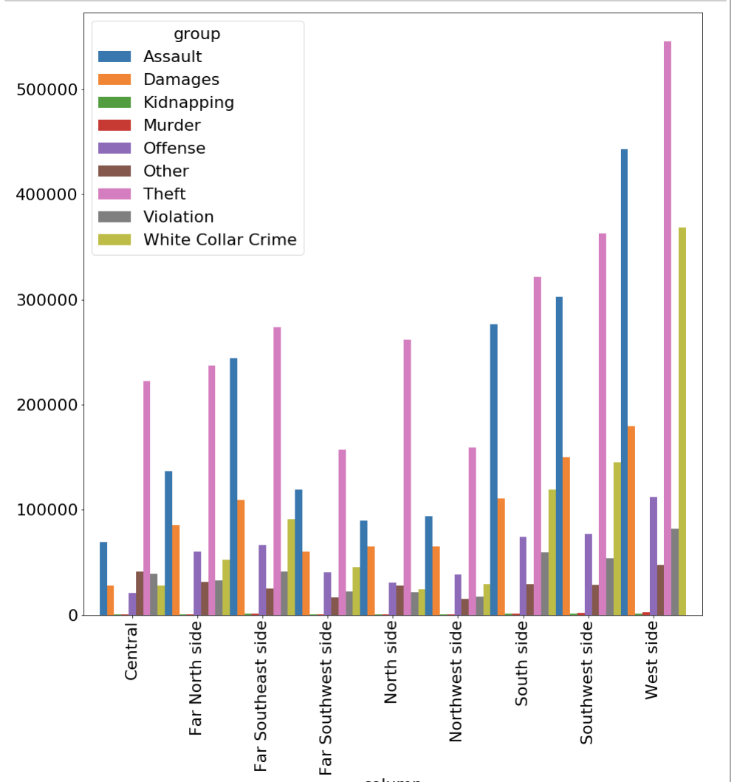
Data Exploration

Slide 16
Data Classification
Used holdout method and Used K-Neighbors Classifier to split dataset and classify the type of ‘Primary Crime Type’. (Test size = 0.25)
Got a F1 score and accuracy score of 0.0792 and 0.339 respectively.

Slide 17
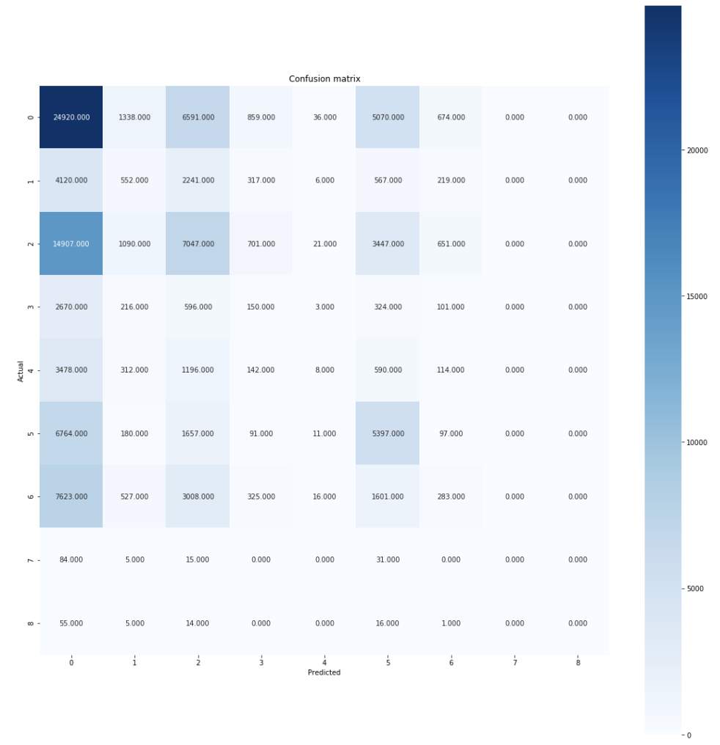
Data Classification

Slide 18
Data Clustering
Clustering, kmeans, k = 9
From our clustering we received a silhouette coefficient of 0.38
From this we can see that the silhouette coefficient is close to 0 so our clusters are not well matched with their own clusters compared to other clusters
From our clustering we received a silhouette coefficient of 0.38
From this we can see that the silhouette coefficient is close to 0 so our clusters are not well matched with their own clusters compared to other clusters

Slide 19
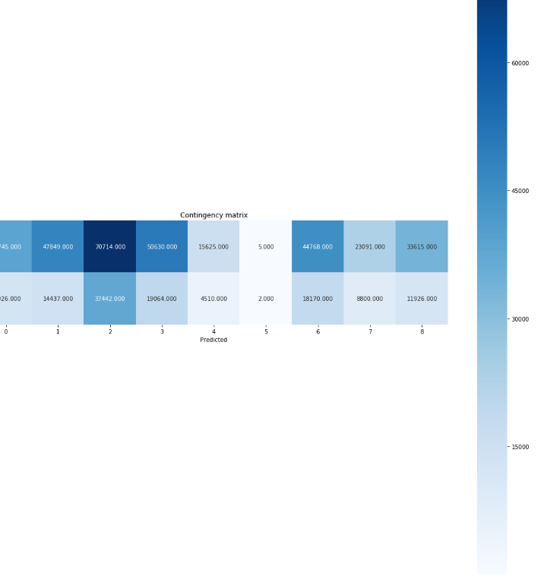
Data Clustering

Slide 20
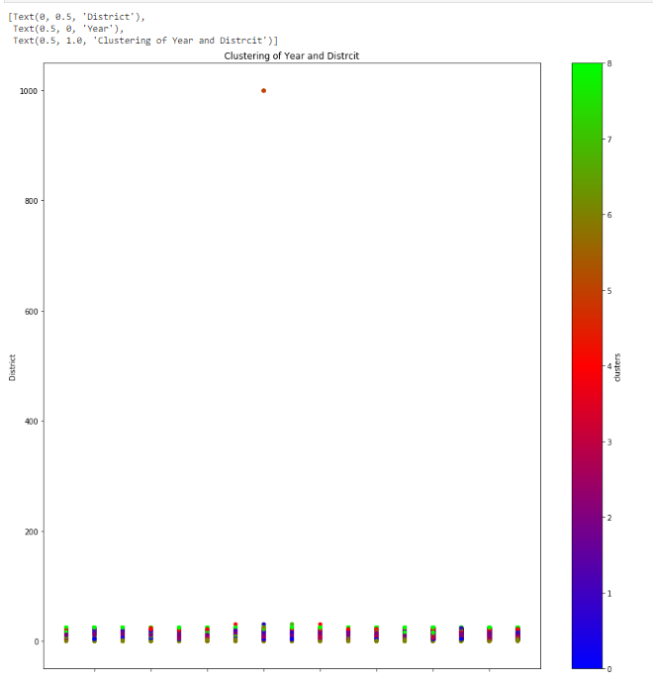
Data Modeling - Clustering

